Slide 1
Sentiment analysis for EPARs

Slide 2
Agenda
Analysis
Assumptions
Approach
Results
Productionalization
Architecture
Process of productionalization
Deployment
Monitoring

Slide 3
Questions
Is the dataset balanced?
Is the amount of data sufficient for allowing a hold-out dataset?
Do you have enough data to consider deep neural architectures or might good feature engineering with more shallow models suffice?
During the data collection process, for some sentences multiple experts disagreed on the sentiment of a given sentence, how could you capture such an ambiguity in your model and potentially notify users about such unclear instances?
How does your model come to a specific conclusion, what about model interpretability?
Think beyond the pure sentiment analysis of sentences, e.g. how would you automatically extract relevant sentences from EPARs and ensure that the analysis is only applied to specific sections? It is worth to explore some EPARs on the EMA website (e.g. consider the ones for Bayer products Eylea1 or Xarelto2).

Slide 4
Architecture
Assumptions: - batch processing
- solution runs on AWS
- data is provided in form of sentencies to analysis
- runs on schedule or by demand

Slide 5
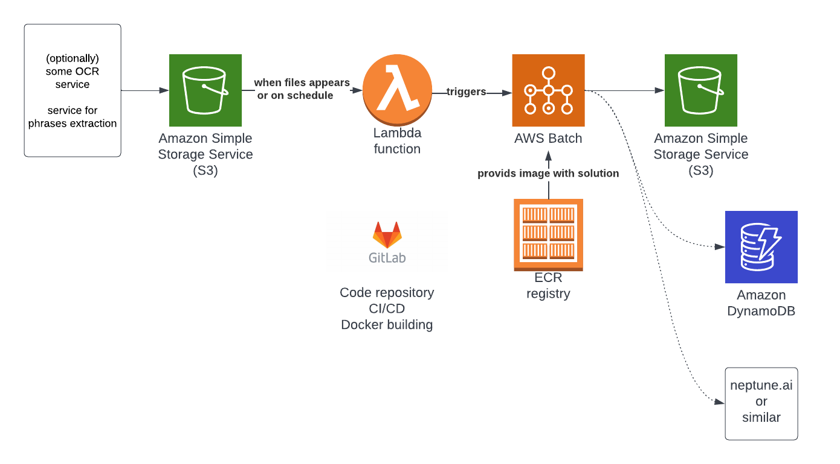
Architecture

Slide 6
Productionalization plan
Assumptions: POC code prepared, model went through experimentation phase and is ready to be operationalized
pipeline building (data engineering)
CI/CD setup w/development flow
code industrialization, ie: refactorization/modularization to achieve production-ready code, unit testing, logging, data import/export handling, sanity checks, documentation
testing
building ML monitoring
deployment (different possible strategies)
monitoring/retraining/testing…

Slide 7
Productionalization - monitoring
ML monitoring:
input data (errors, data drift, outliers)
model monitoring (versioning, configuration)
predictions (evaluation, model drift)
Other:
cost monitoring
data pipeline monitoring

Slide 8
Tools and methods for monitoring

Slide 9
Metric | Input data / predictions | Sanity check / model monitoring

